Slide 1
OC meeting: Thesis presentation
Organization of conceptual knowledge within brain networks
Candidate: Aidas Aglinskas. Supervisor: Scott L. Fairhall

Slide 2
Overview
Goal: to investigate how cognitions are represented across brain networks
Chapter 1. Behavioral data
Chapter 2. Person knowledge – faces
Chapter 3. Person knowledge – names
Chapter 4. Broad semantic knowledge

Slide 3
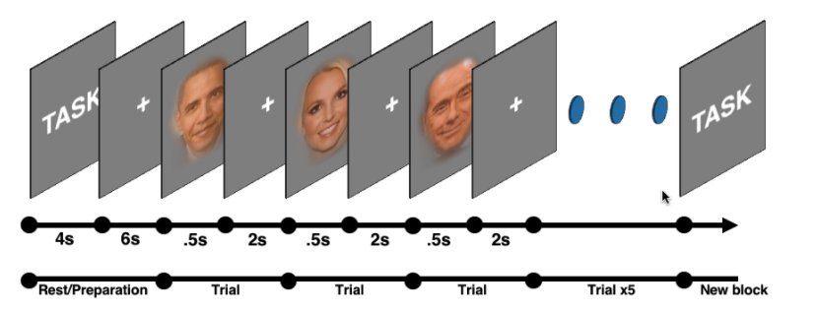
Experimental design (exp 1 & 2)
- Healthy volunteers were presented with either photographs (N=20) or names (N=24) of celebrities and were asked to recall person specific information
- Question spanned nominal, physical, social, episodic and biographical knowledge
Name?
Common name?
Attractive?
Distinctive face?
Friendly?
Trustworthy?
Familiar?
First memory?
Job?
Know much about?

Slide 4
Chapter 1: Behavioral data
investigation of the behavioural indicators of the relationship between different knowledge and processing of people

Slide 5
Chapter 1: Behavioral data
investigation of the behavioural indicators of the relationship between different knowledge and processing of people
Measured by: RT similarity, response similarity, subjective similarity

Slide 6
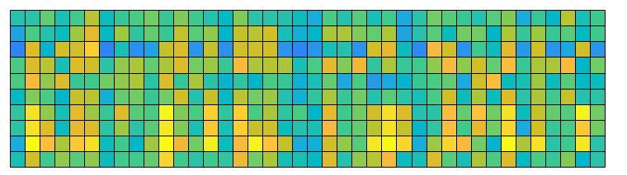
Chapter 1: Behavioral data
Cognitions
Measured by: RT similarity, response similarity, subjective similarity
People

Slide 7
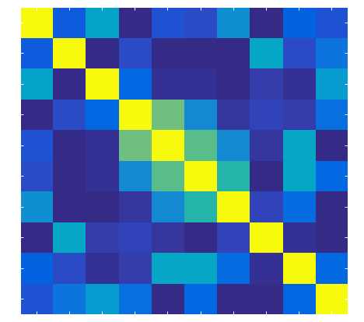

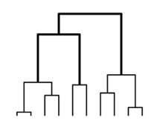

Chapter 1: Behavioral data
Cognitions
Measured by: RT similarity, response similarity, subjective similarity
People

Slide 8
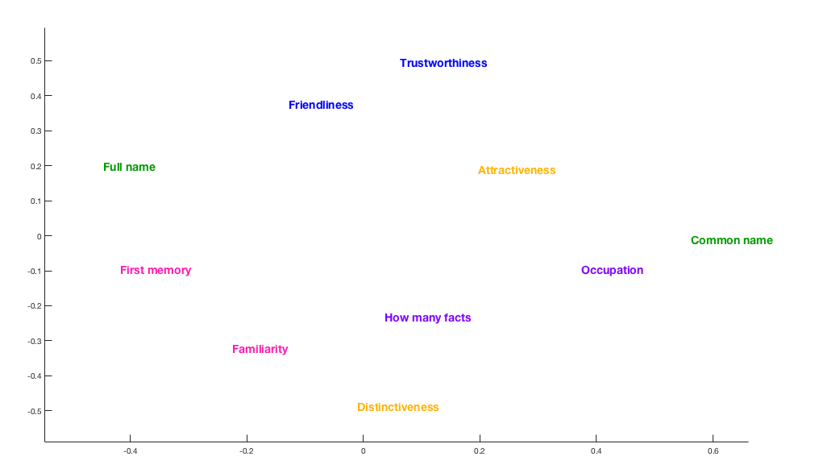
Chapter 1: Behavioral data
Measured by: RT similarity, response similarity, subjective similarity

Slide 9
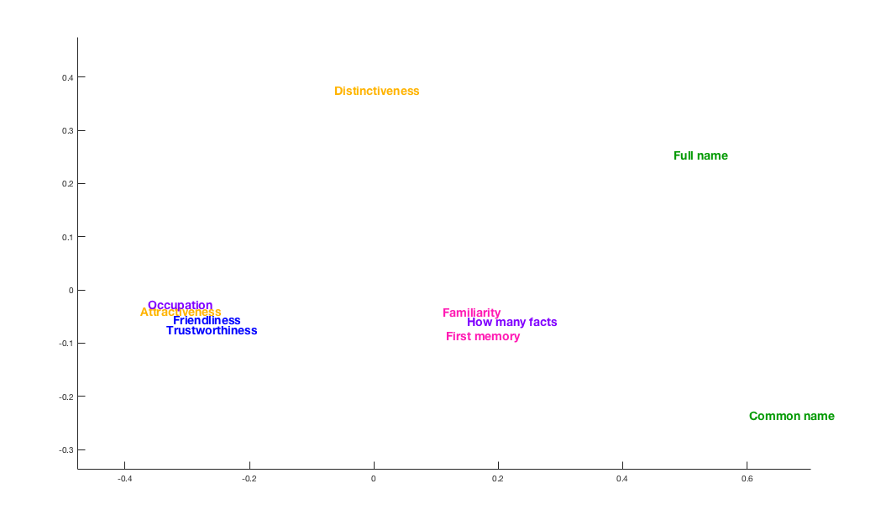
Chapter 1: Behavioral data
Measured by: RT similarity, response similarity, subjective similarity

Slide 10
Chapter 1: Behavioral data
Measured by: RT similarity, response similarity, subjective similarity

Slide 11
Chapter 1: Behavioral data
Measured by: RT similarity, response similarity, subjective similarity

Slide 12
Chapter 1: Behavioral data
Measured by: RT similarity, response similarity, subjective similarity

Slide 13
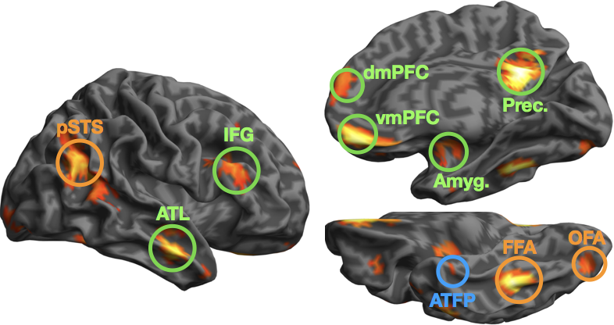
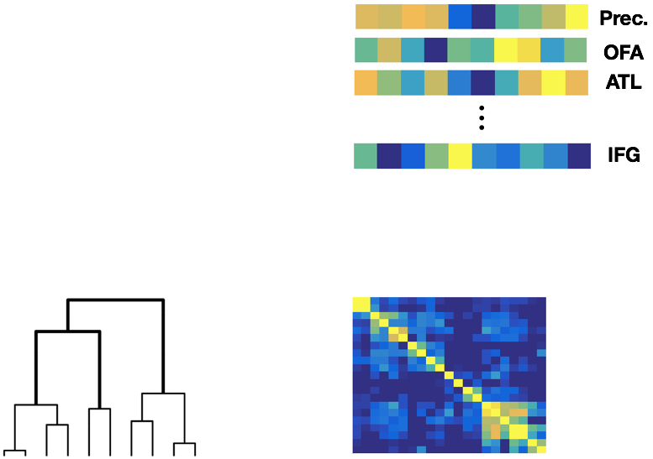
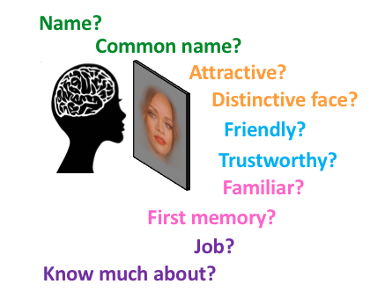
Chapter 2: Faces
- Data were extracted from independently defined ROIs (N=42), regionally averaged, correlated and subjected to clustering analysis.

Slide 14
Chapter 2: Faces
Goals:
Address competing hypotheses about regional function.
E.g. ATL in nominal, social or semantic processing
Gain insight into systems-level organisation

Slide 15
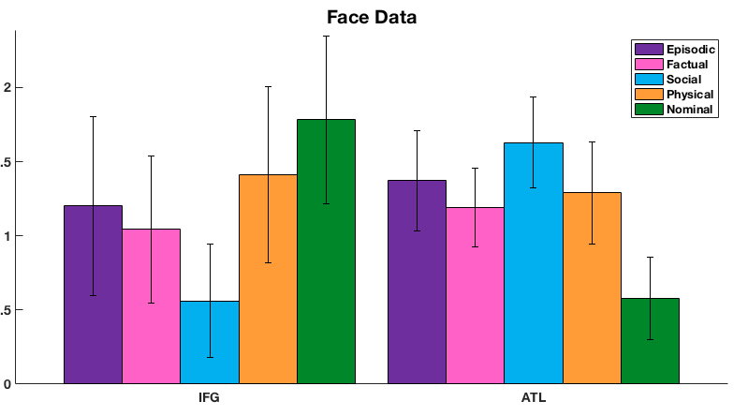
Chapter 2: Faces
ATL shows cognitive tuning for social tasks while IFG shows preference for proper naming tasks instead.

Slide 16
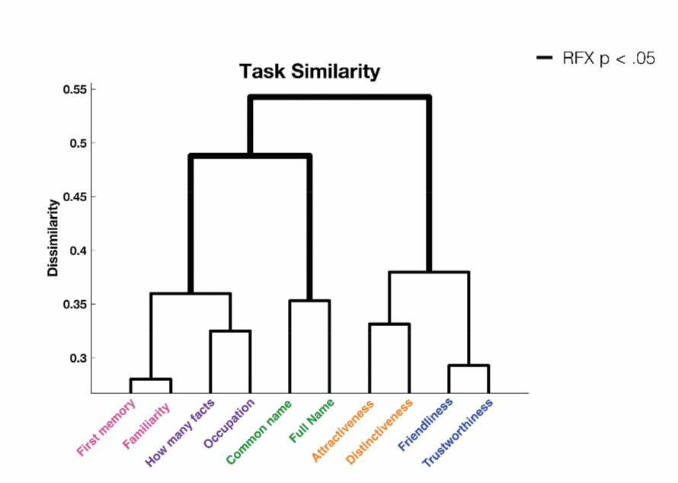
Chapter 2: Faces
Accessing episodic & biographical knowledge relies on similar neural substrates, as does physical as social knowledge.
Nominal knowledge retrieval relies on a unique topography.

Slide 17
Chapter 2: Faces
Core regions (OFA, FFA, pSTS) form coordinate with frontal (OFC & IFG) regions, possibly reflecting top-down control.
Regions in the internalized semnatic network preserve their relationship during task.
atFP shares representational similarity with Amygdala

Slide 18
Chapter 3: Names
Replication and extension.
Name?
Common name?
Attractive?
Distinctive face?
Friendly?
Trustworthy?
Familiar?
First memory?
Job?
Know much about?

Slide 19
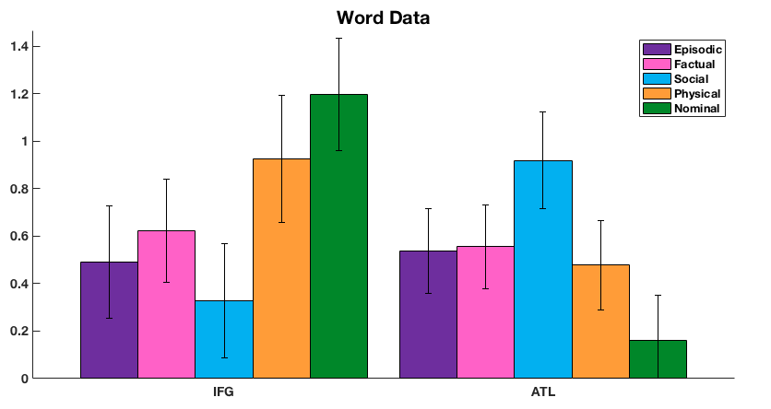
Chapter 3: Names

Slide 20
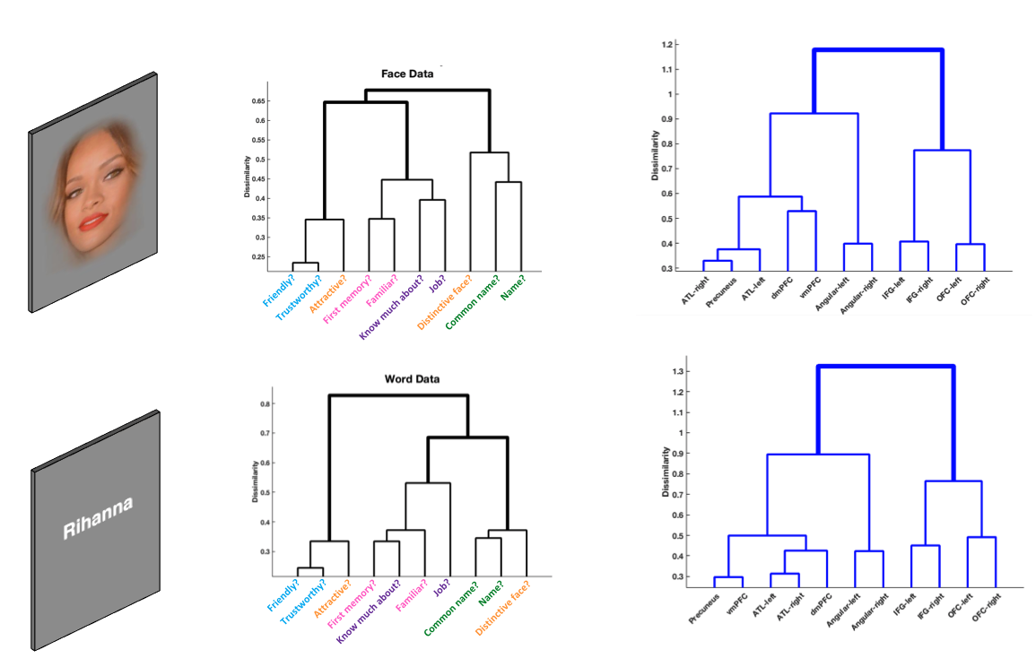
Chapter 3: Names

Slide 21
Chapter 3: Names

Slide 22
Chapter 4: Broad semantic categories
- Different categories selected from a large corpus (in progress)

Slide 23
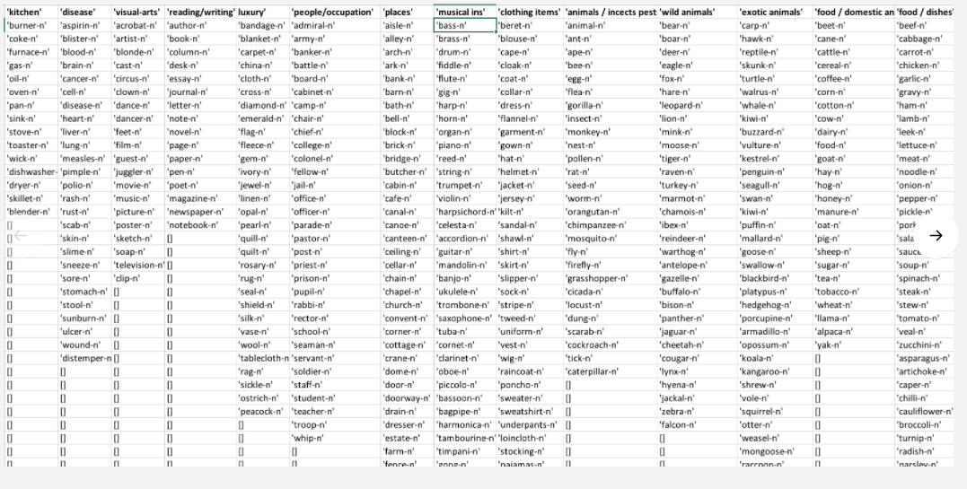
Chapter 4: Broad semantic categories
- Different categories selected from a large corpus

Slide 24
Chapter 4: Broad semantic categories
- Different categories selected from a large corpus
- ~16 categories, ~16 items per category, typicality task
- Goal is to investigate semantic organization across stimulus categories

Slide 25
Thank you

Slide 26
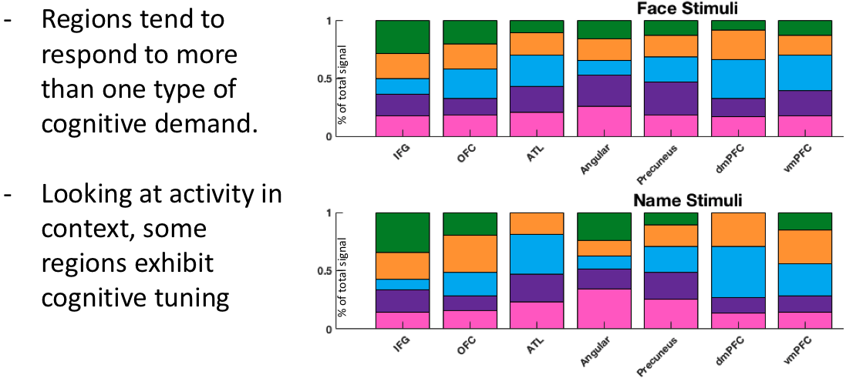
Chapter 3: Names

Slide 27
Chapter 4: Broad semantic categories
In progress

Slide 28
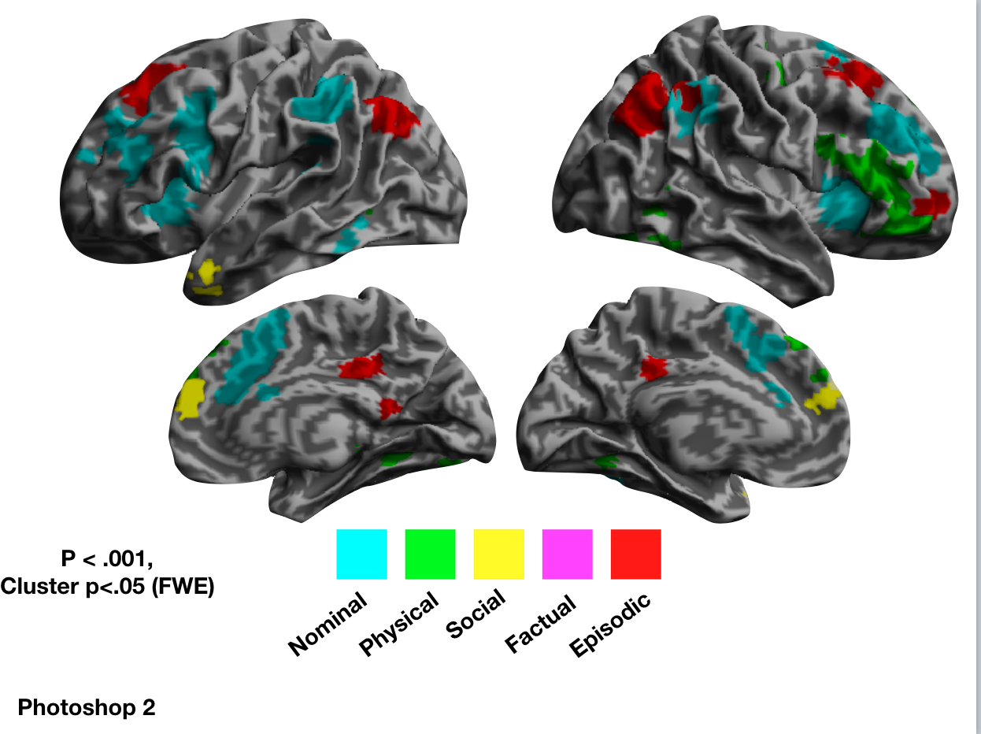
Accessing different kinds of person knowledge

Slide 29
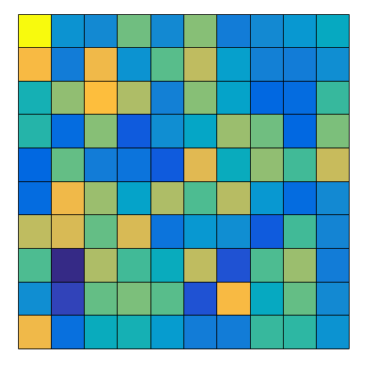
OFA
pSTS
Amyg.
ATFP
ATL
dmPFC
vmPFC
Prec.
FFA
Name?
Common name?
Attractive?
Distinctive face?
Friendly?
Trustworthy?
Familiar?
First memory?
Job?
Know much about?

